Slide 1
Chapter 1: Exceptions & Java Language Package

Slide 2
Learning Objectives
Introduction
Exception Hierarchy
Difference between Exception & Error
Exception handling using : try-catch-finally
Methods to display error information.
Checked and Unchecked exceptions
Multiple catch blocks.
Nested try blocks
User defined exceptions (Customized Exceptions)
Throw and Throws
Hierarchy
Object class
Strings
StringBuffer & StringBuilder(jd1.5)
Wrapper classes
Autoboxing and Unboxing(jdk1.5)

Slide 3
Exceptions
Many developers are misguided by the term exception handling. These developers believe that the word exception is related to how frequently something happens.
For example, a developer designing a file Read method is likely to say the following: “ When reading from a file, you will eventually reach the end of its data. Since reaching the end will always happen, I’ll design my Read method so that it reports the end by returning a special value; I won’t have it throw an exception.”
The problem with previous statement is that it is being made by the developer designing the Read method, not by the developer calling the Read method. When designing the Read method, it is impossible for the developer to know all of the possible situations in which the method gets called.
Therefore, the developer can’t possible know how often the caller if the Read method will attempt to read past the end of the file. In fact, since most files contain structured data, attempting to read past the end of a file is something that rarely happens.
An exception means that an action member cannot complete the task it was supposed to perform as indicated by its name.

Slide 4
What Exactly Is an Exception?
Look at the following class definition:
class Account{
public static void Transfer(Account from, Account to, float amount) {
…
}
}
The Transfer method accepts two Account objects and a float value that identifiers an amount of money to transfer between accounts. The Transfer method could failed for many reasons, like from or to argument might be null.
When the Transfer method is called, its code must check for all the failed possibilities, and if any of which is detected, it cannot transfer the money and should notify the caller that it failed by throwing an exception.
The Transfer method transfers money from one account to another. If this method doesn’t validate its arguments right away, the method could subtract money from the from account successfully, and then discover that the to account argument is null.
At this point, the method would throw an exception because it cannot transfer that money. However, the method must also add that money back to the from account. If it fails to do this, the state of the from account is incorrect.

Slide 5
Don’t Catch Everything
A ubiquitous mistake made by developers who have not been properly trained on the proper use of exceptions is to use catch blocks too frequently and often improperly.
When you catch an exception, you’re stating that you expected this exception, you understand why it occurred, and you know how to deal with it. In other words, you’re defining a policy for the application.
This code indicates that it was expecting any and all exceptions and knows how to recover from any and all situations.
try {
//try to execute code that the programmer knows might fail..
}
catch (exception) {
…
}

Slide 6
Don’t Catch Everything (Contd…)
A type that’s part of a class library should never catch and swallow all exceptions because there is no way for the type to know exactly how the application intends to respond to an exception.
If the application code throws an exception, another part of the application is probably expecting to catch this exception. The exception should be allowed to filter its way up the call stack and let the application code handle the exception as it sees fits.
In addition, it is possible that an exception was thrown because some object was in a bad state. If library code catches and swallows the exception, the program continues running with unpredictable results and with potential security vulnerabilities.
It is better for the exception to be unhandled and for the application to terminate.
In fact, most unhandled exceptions will be discovered during testing of your code. To fix these unhandled exception, you will either modify the code to look for specific exception, or you will rewrite the code to eliminate the conditions that cause the exception to be thrown.
The final version of the code that will be running in a production environment should see very few (if any) unhandled exceptions and be extremely robust.

Slide 7
Exceptions and the Java Virtual Machine
When an exception takes place, the JVM creates an exception object to identify the type of exception that occurred
The Throwable class is the super class of all error and exception types generated by the JVM or java programs
Three Throwable subclass categories are possible: Error, Runtime and Non-Runtime Exceptions

Slide 8
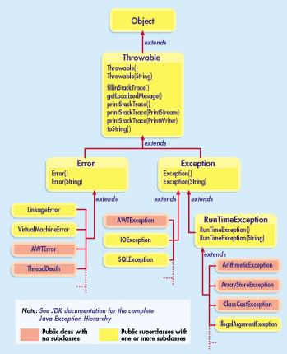
Exception Hierarchy

Slide 9
Exceptions and Errors
When a problem encounters and unexpected termination or fault, it is called an exception
When we try and divide by 0 we terminate abnormally.
Exception handling gives us another opportunity to recover from the abnormality.
Sometimes we might encounter situations from which we cannot recover like OutOfMemory. These are considered as errors.

Slide 10
Checked and Unchecked Exception
Exceptions which are checked for during compile time are called checked exceptions.
Example: SQLException or any userdefined exception extending the Exception class
Exceptions which are not checked for during compile time are called unchecked exception.
Example: NullPointerException or any class extending the RuntimeException class.
All the checked exceptions must be handled in the program.
The exceptions raised, if not handled will be handled by the Java Virtual Machine. The Virtual machine will print the stack trace of the exception indicating the stack of exception and the line where it was caused.

Slide 11
Runtime Exceptions
Runtime (unchecked exceptions):
Arithmetic Exceptions: dividing by zero
Null Pointer Exceptions: attempting to reference a method of a null pointer
Class Cast Exception: casting incompatible object, super or subclass types
Index Out of Bounds Exception: accessing a index value outside of an array range
Typically result from logical errors

Slide 12
Exception Handling Terms
throw – to generate an exception or to describe an instance of an exception
try – used to enclose a segment of code that may produce a exception
catch – placed directly after the try block to handle one or more exception types
finally – optional statement used after a try-catch block to run a segment of code regardless if a exception is generated.
throws – If you don’t want the exception to be handled in the same function you can use the throws class to handle the exception in the calling function.

Slide 13
Catching Multiple exceptions
We can have multiple catch blocks for a single try statement. The exception handler looks for a compatible match and then for an exact match. In other words, in the example, if the exception raised was myIOCustomException, a subclass of FileNotFoundException, then the catch block of FileNotFoundExeception is matched and executed.
If a compatible match is found before an exact match, then the compatible match is preferred.
We need to pay special attention on ordering of exceptions in the catch blocks, as it can lead to mismatching of exception and unreachable code.
We need to arrange the exceptions from specific to general.
Once a try statement has been used to enclose a code segment, the catch can be used to handle one or more specific exception types. By defining catch statements for specific exception types, a more accurate handling of the exception can be tailored to the programs needs

Slide 14
Some Java built-in exceptions
ArithmeticException
ArrayIndexOutOfBounds
ArrayStore
ClassCast
IllegalArgument
IllegalState
IllegalThreadState

Slide 15
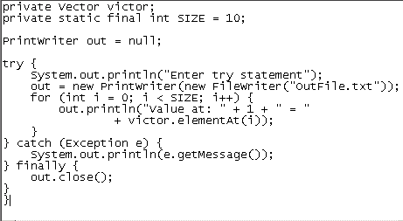
The finally statement
The purpose of the optional finally statement will allow the execution of a segment of code regardless if the try statement throws an exception or executes successfully
The advantage of the finally statement is the ability to clean up and release resources that are utilized in the try segment of code that might not be released in cases where an exception has occurred.

Slide 16
Define your own exception
Here is a code sample showing how to define your own exception.
Define a class:
public class EmptyStackException extends Exception
{}
It needs to inherit from the Exception class.
Here is how you use the class:
public class Stack {
public Object Pop() throws EmptyStackException {
if (Empty()) throw new EmptyStackException(); ...
}
}
Note that you must use new to create an exception object; you cannot just throw an exception..

Slide 17
Examples: Chapter 1
See COREJ2-Chapter1 at https://github.com/CompleteJavaTraining/JavaEssentials/tree/master/Code/COREJ2-Chapter1

Slide 18
What is java.lang Package
Provides classes that are fundamental to the design of the Java programming language. Some of the types defined in the package are:
Object, the ultimate superclass of all classes in Java
Thread, the class that controls each thread in a multithreaded program
Throwable, the superclass of all error and exception classes in Java
Classes that encapsulate the primitive data types in Java
Classes for accessing system resources and other low-level entities
Math, a class that provides standard mathematical methods
String, the class that is used to represent strings
java.lang is implicitly imported in every Java source file.

Slide 19
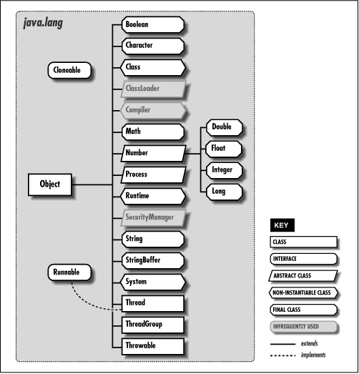
Hierarchy of The Objects in java.lang Package

Slide 20
java.lang.Object Class
Class Object is the root of the class hierarchy.
Every class has Object as a superclass.
All objects, including arrays, implement the methods of this class.
If a class doesn’t extend another class, then compiler extends it from Object.
Method Summary
protected Object | clone()
boolean | equals(Object obj)
protected void | finalize()
Class<? extends Object> | getClass()
int | hashCode()
void | notify()
void | notifyAll()
String | toString()
void | wait()
void | wait(long timeout)
void | wait(long timeout, int nanos)

Slide 21
Java.lang.Class Class
Declaration: public final class Class extends Object implements Serializable, GenericDeclaration, Type, AnnotatedElement
Instances of the class Class represent classes and interfaces in a running Java application.
Every array also belongs to a class that is reflected as a Class object that is shared by all arrays with the same element type and number of dimensions.
The primitive Java types (boolean, byte, char, short, int, long, float, and double), and the keyword void are also represented as Class objects.
Class has no public constructor. Instead Class objects are constructed automatically by the Java Virtual Machine as classes are loaded in the class loader.

Slide 22
java.lang.Class Class members
Method Summary (Partial List)
static Class | forName(String className)
Class[] | getClasses()
Constructor[] | getConstructors()
Field[] | getFields()
Class[] | getInterfaces()
Method[] | getMethods()
int | getModifiers()
String | getName()
Package | getPackage()
String | getSimpleName()
Class | getSuperclass()
boolean | isArray()
boolean | isInstance(Object obj)
boolean | isInterface()
boolean | isLocalClass()
boolean | isMemberClass()
boolean | isPrimitive()

Slide 23
java.lang.String Class
Declaration: public final class String extends Object implements Serializable, Comparable<String>, CharSequence
The String class represents character strings. All string literals in Java programs are implemented as instances of this class.
Strings are immutable, their values cannot be changed after they are created
The class String includes methods for examining individual characters of the sequence, for comparing strings, for searching strings, for extracting substrings, and for creating a copy of a string with all characters translated to uppercase or to lowercase.

Slide 24
java.lang.String class members
Method Summary (Partial List)
char | charAt(int index)
int | compareTo(String anotherString)
String | concat(String str)
boolean | contains(CharSequence s)
boolean | endsWith(String suffix)
boolean | equals(Object anObject)
static String | format(String format, Object... args)
int | hashCode()
int | indexOf(int ch)
int | length()
boolean | matches(String regex)
String | replace(char oldChar, char newChar)
String[] | split(String regex)
boolean | startsWith(String prefix)
String | substring(int beginIndex)
String | toLowerCase()
String | toUpperCase()
String | trim()

Slide 25
java.lang.StringBuilder Class
public final class StringBuilder extends Object implements Serializable, charSequence
The java.lang.StringBuilder class is mutable sequence of characters. This provides an API compatible with StringBuffer, but with no guarantee of synchronization.
StringBuilder class has been supplemented with an equivalent class designed for use by multiple threads, StringBuffer.
The StringBuffer class should generally be used in preference to StringBuilder in multithreaded scenarios as it supports all of the same operations but is synchronized for access by multiple threads.

Slide 26
java.lang.StringBuilder class members
Method Summary (Partial List)
StringBuilder | append(String str)
StringBuilder | append(StringBuffer sb)
int | capacity()
char | charAt(int index)
StringBuilder | delete(int start, int end)
StringBuilder | deleteCharAt(int index)
int | indexOf(String str)
StringBuilder | insert(int offset, String str)
int | lastIndexOf(String str)
int | length()
StringBuilder | replace(int start, int end, String str)
StringBuilder | reverse()
void | setCharAt(int index, char ch)
void | setLength(int newLength)
String | substring(int start)
String | substring(int start, int end)
String | toString()
void | trimToSize()

Slide 27
java.lang.StringBuffer Class
Declaration: public final class StringBuffer extends Object implements Serializable, CharSequence
StringBuffer is a thread-safe, mutable sequence of characters. A StringBuffer is like a String, but can be modified.
StringBuffer class has been supplemented with an equivalent class designed for use by a single thread, StringBuilder.
The StringBuilder class should generally be used in preference to StringBuffer as it supports all of the same operations but is faster as it performs no synchronization.

Slide 28
java.lang.StringBuffer class members
Method Summary (Partial List)
StringBuffer | append(String str)
StringBuffer | append(StringBuffer sb)
int | capacity()
char | charAt(int index)
StringBuffer | delete(int start, int end)
StringBuffer | deleteCharAt(int index)
int | indexOf(String str)
StringBuffer | insert(int offset, String str)
int | lastIndexOf(String str)
int | length()
StringBuffer | replace(int start, int end, String str)
StringBuffer | reverse()
void | setCharAt(int index, char ch)
void | setLength(int newLength)
String | substring(int start)
String | substring(int start, int end)
String | toString()
void | trimToSize()

Slide 29
Wrapper Classes Constructors
Primitive
Wrapper Class
Constructor Arguments
boolean
Boolean
boolean or String or null
byte
Byte
byte of String
char
Character
char
double
Double
double or String
float
Float
float, double, or String
int
Integer
int or String
long
Long
long or String
short
Short
short or String

Slide 30
Auto-boxing and Unboxing
Box
An instance of a wrapper class that holds a value of a primitive type
Creating a box for a primitive value
Unboxing
Removing the primitive value from a box
Java won’t let you use a primitive value where an object is required--you need a “wrapper”
myVector.add(new Integer(5));
Similarly, you can’t use an object where a primitive is required--you need to “unwrap” it
int n = ((Integer)myVector.lastElement()).intValue();

Slide 31
Auto-boxing and Unboxing – contd…
Java 5 and later makes this automatic:
Vector<Integer> myVector = new Vector<Integer>(); myVector.add(5); int n = myVector.lastElement();
Other extensions make this as transparent as possible
For example, control statements that previously required a boolean (if, while, do-while) can now take a Boolean.

Slide 32
Examples: Chapter 1
See COREJ2-Chapter1 at https://github.com/CompleteJavaTraining/JavaEssentials/tree/master/Code/COREJ2-Chapter1

Slide 33
What are we learning in Next Chapter ?
You will learn about Java Beans & Multi-Threading
We will learn about:
Bean Properties
Bean Methods
Bean Events
Using BeanInfo class
Bean Persistence (Long and Short - Serializable interface, XmlEncoder class)
Instrospection Mechanism
Introduction to Threads and Concurrency
Defining, Instantiating, and Starting threads by
"Extending Thread class implementing Runnable interface"
Main thread
Thread Priorities
Thread names
Sleep(), Join()
Daemon threads
Synchronization
Interthread communication

Slide 34
Thank You !

